Slide 1
Jack Voltaic 4.0 and Cybersecurity Resilience Getting Critical Infrastructure Stakeholders to the Table Through Resilience Games
Dr. David I. Schwartz
Dr. Jessica D Bayliss
Dr. Karen Guttieri
Dr. Aldo David Abitbol
Dr. Chao Peng
Dr. Christopher Schwartz
Dr. Brian Tomaszewski
MORS Global Critic Infrastructure Workshop | 22-24 October 2024 | Garmisch, Germany

Slide 2
Abstract (for reference)
Government agencies typically run tabletop exercises with stakeholders (managers, operators, etc.) of critical infrastructure (power, communications, etc.) for disaster scenarios. Stakeholders must overcome reluctance about cybersecurity, collaborate, and keep learning. From the Army Cyber Institute (ACI), JACK VOLTAIC™ (JV) explores concerns about resilience to cybersecurity attacks against multiple critical infrastructure sectors. The stakeholders first need to engage and overcome a fear of exposing a lack of knowledge or confidence. This year, our team will release an open-source version, JV4.0, to address the convergence of cybersecurity and physical disasters, continuing the work presented at MORS 91, ID 66172. JV4.0 includes a framework for game designers to modify provided games or create new ones. Leveraging inspiration from successful games like “Backdoors & Breaches” and “Stone Age,” JV4.0 uses digital card game mechanics. We anticipate that JV4.0 will get people to a proverbial table, especially by encouraging replay and collaboration. We designed JV 4.0 to take advantage of the fact that most people have played card games, perhaps educating populations with their stakeholders. In our proposed presentation, we will demonstrate JV4.0’s framework, card-based gameplay, built-in networking, how we use AI for red and blue teams, white event cards, the ease of editing digital cards to create new games, and how to fork JV4.0 to create new frameworks.
Notes:
From Germany MORS abstract submission (Oct 2024)

Slide 3

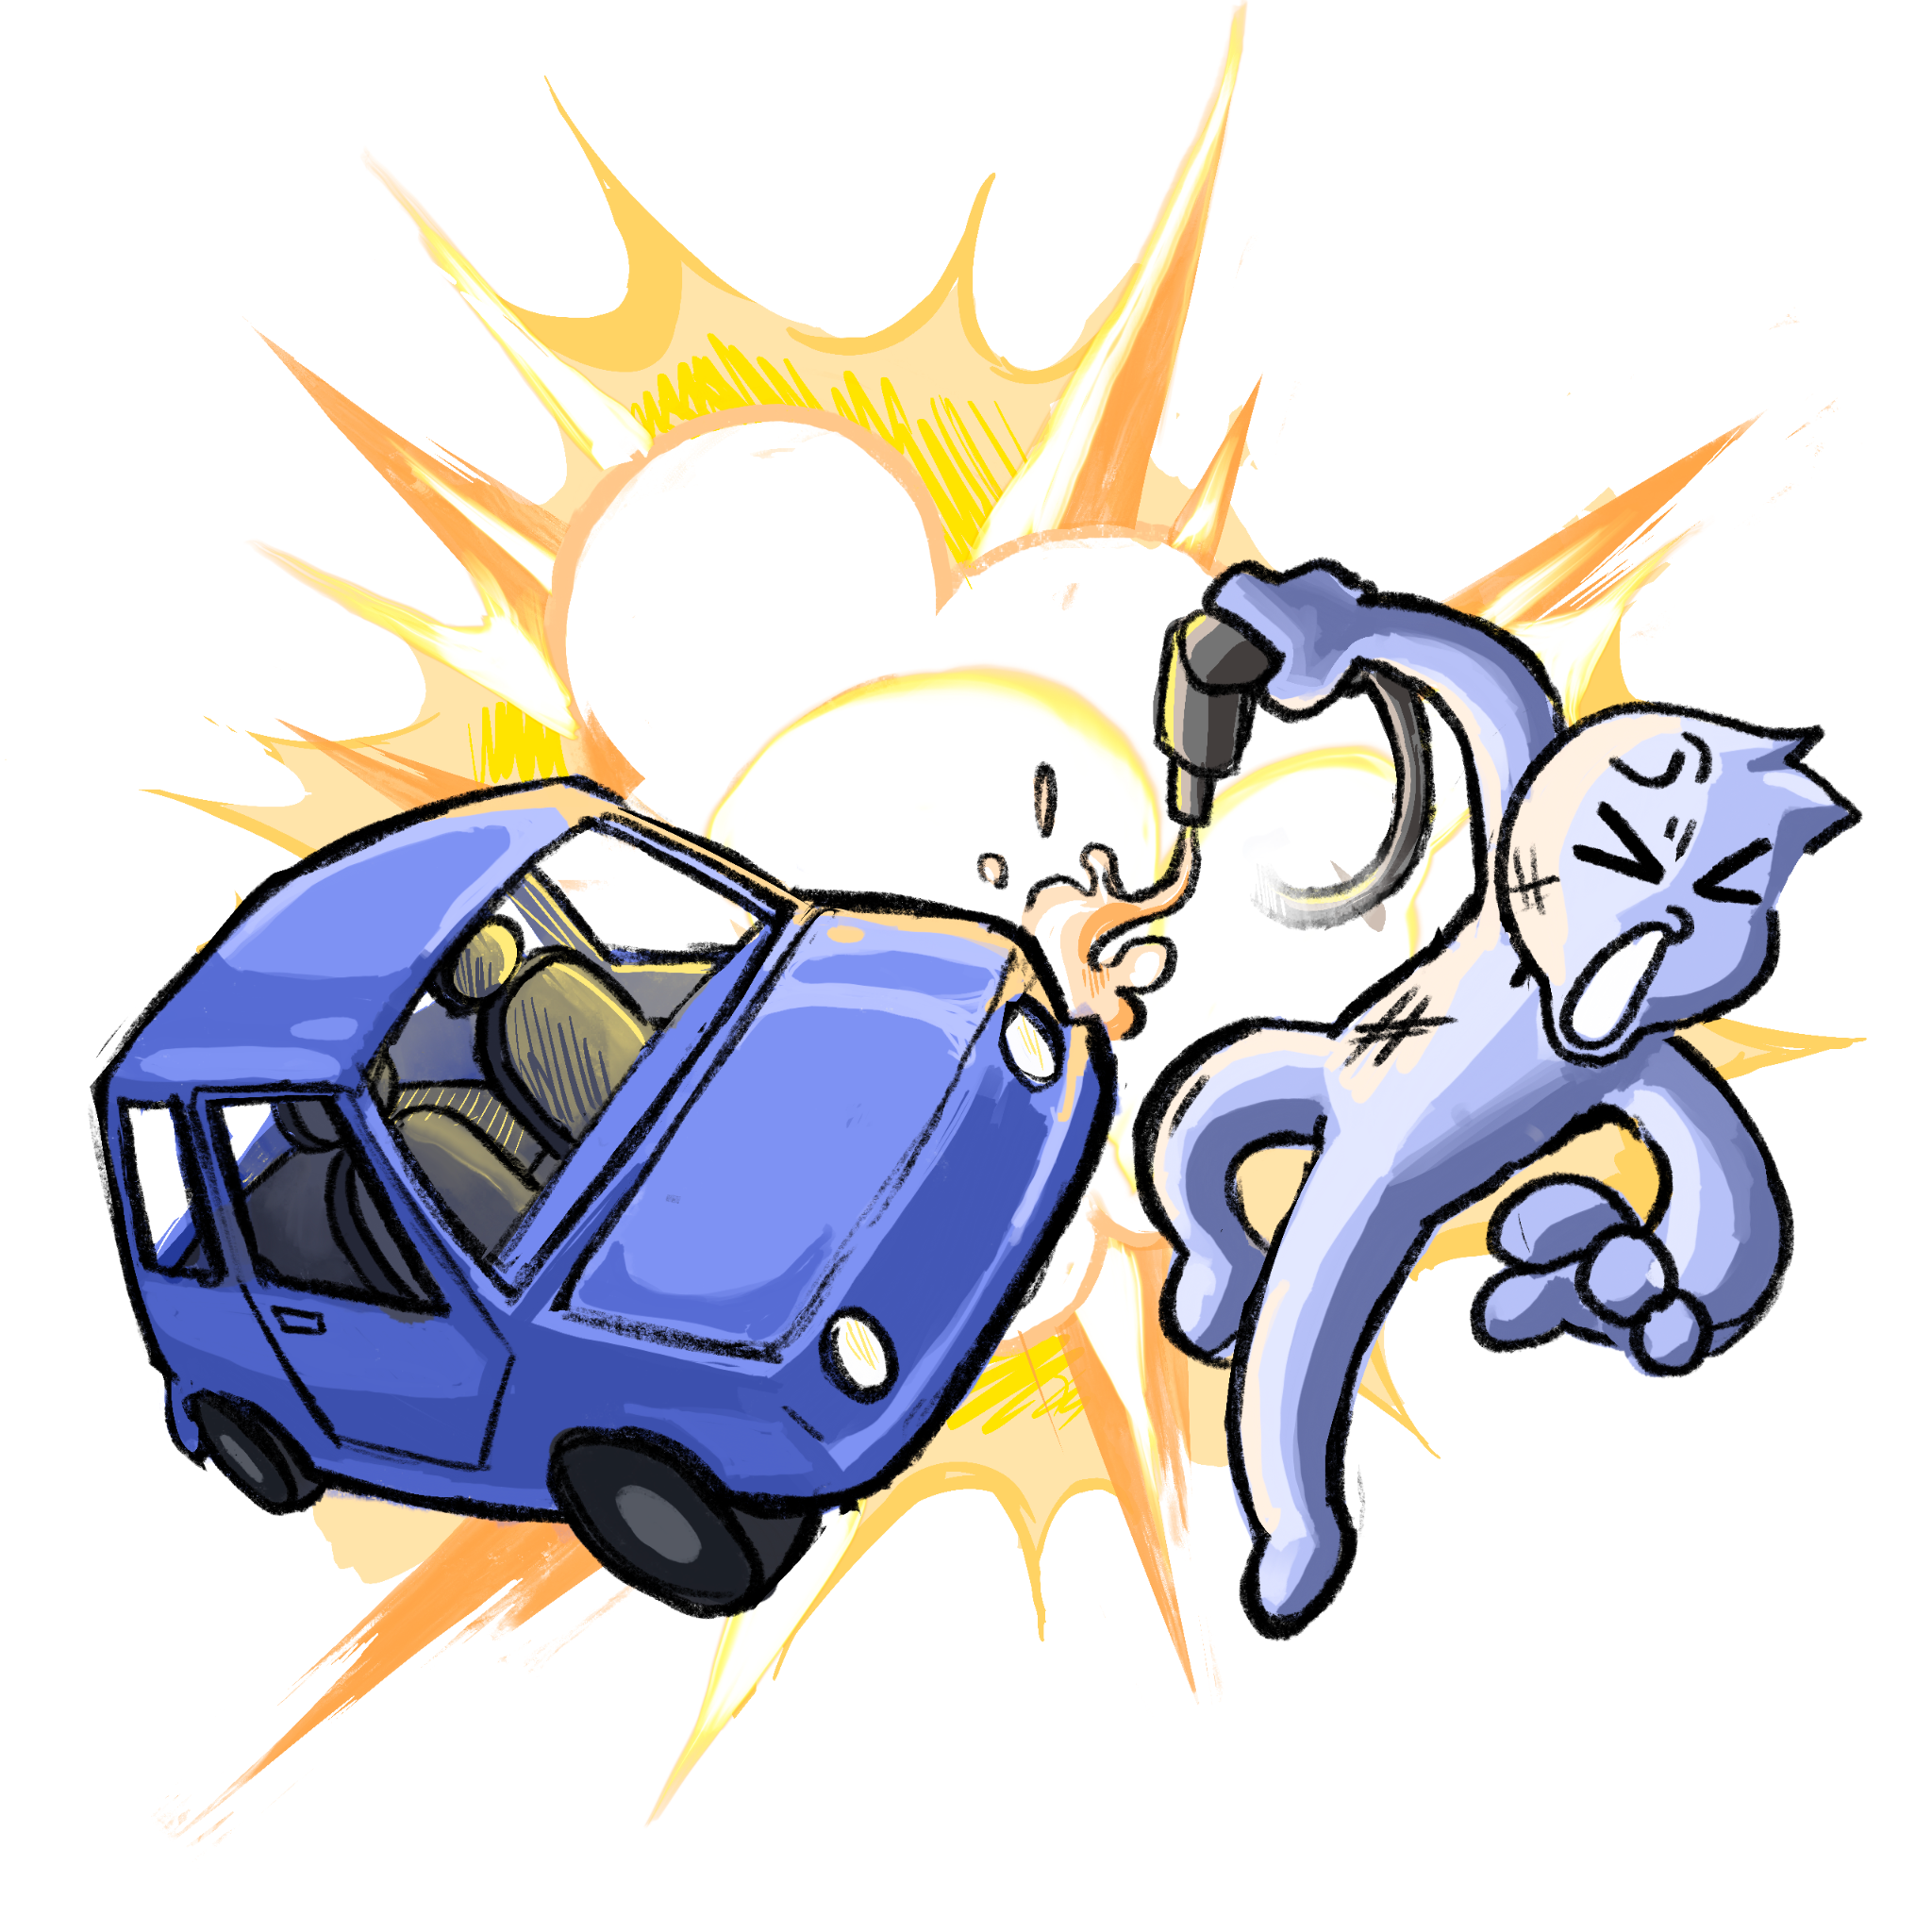
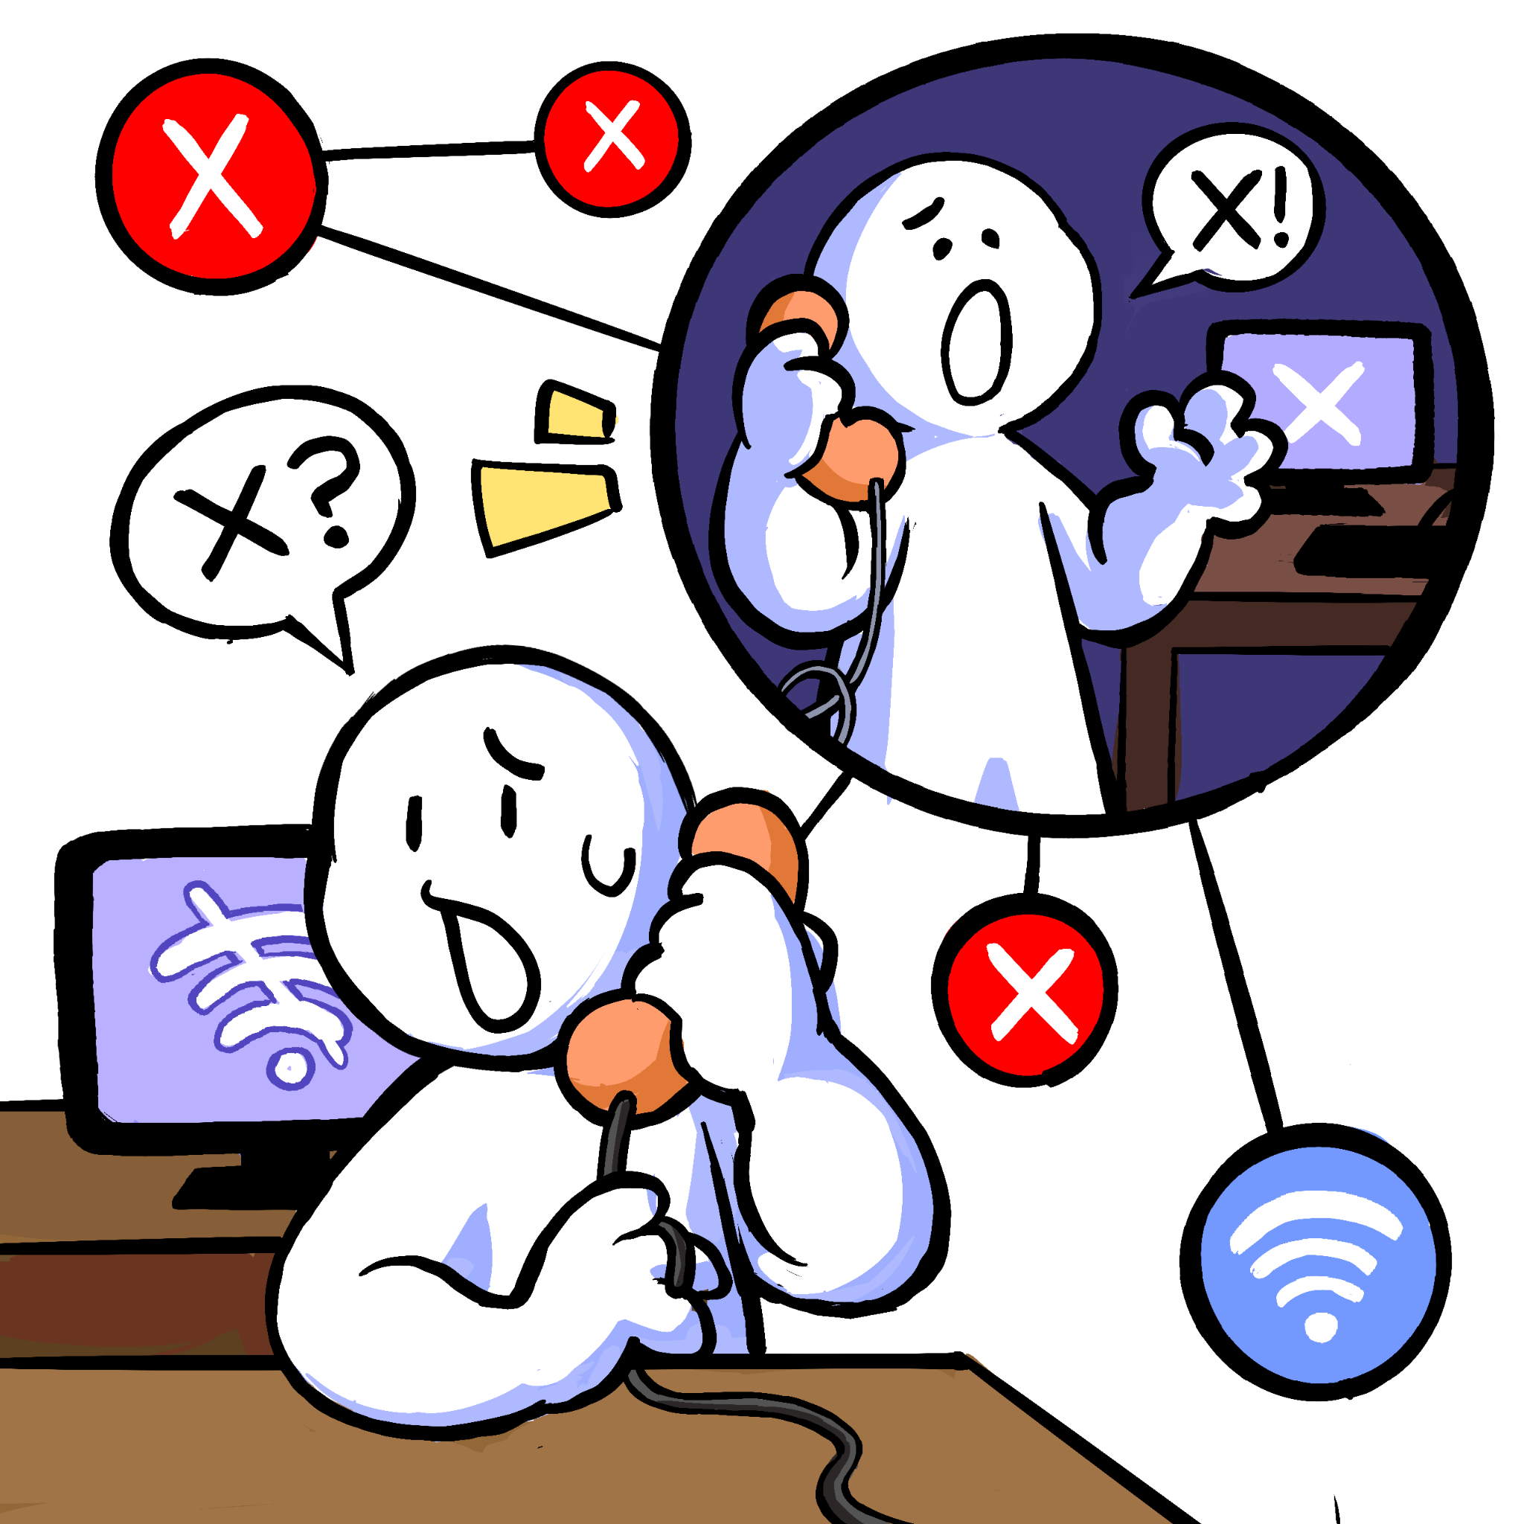
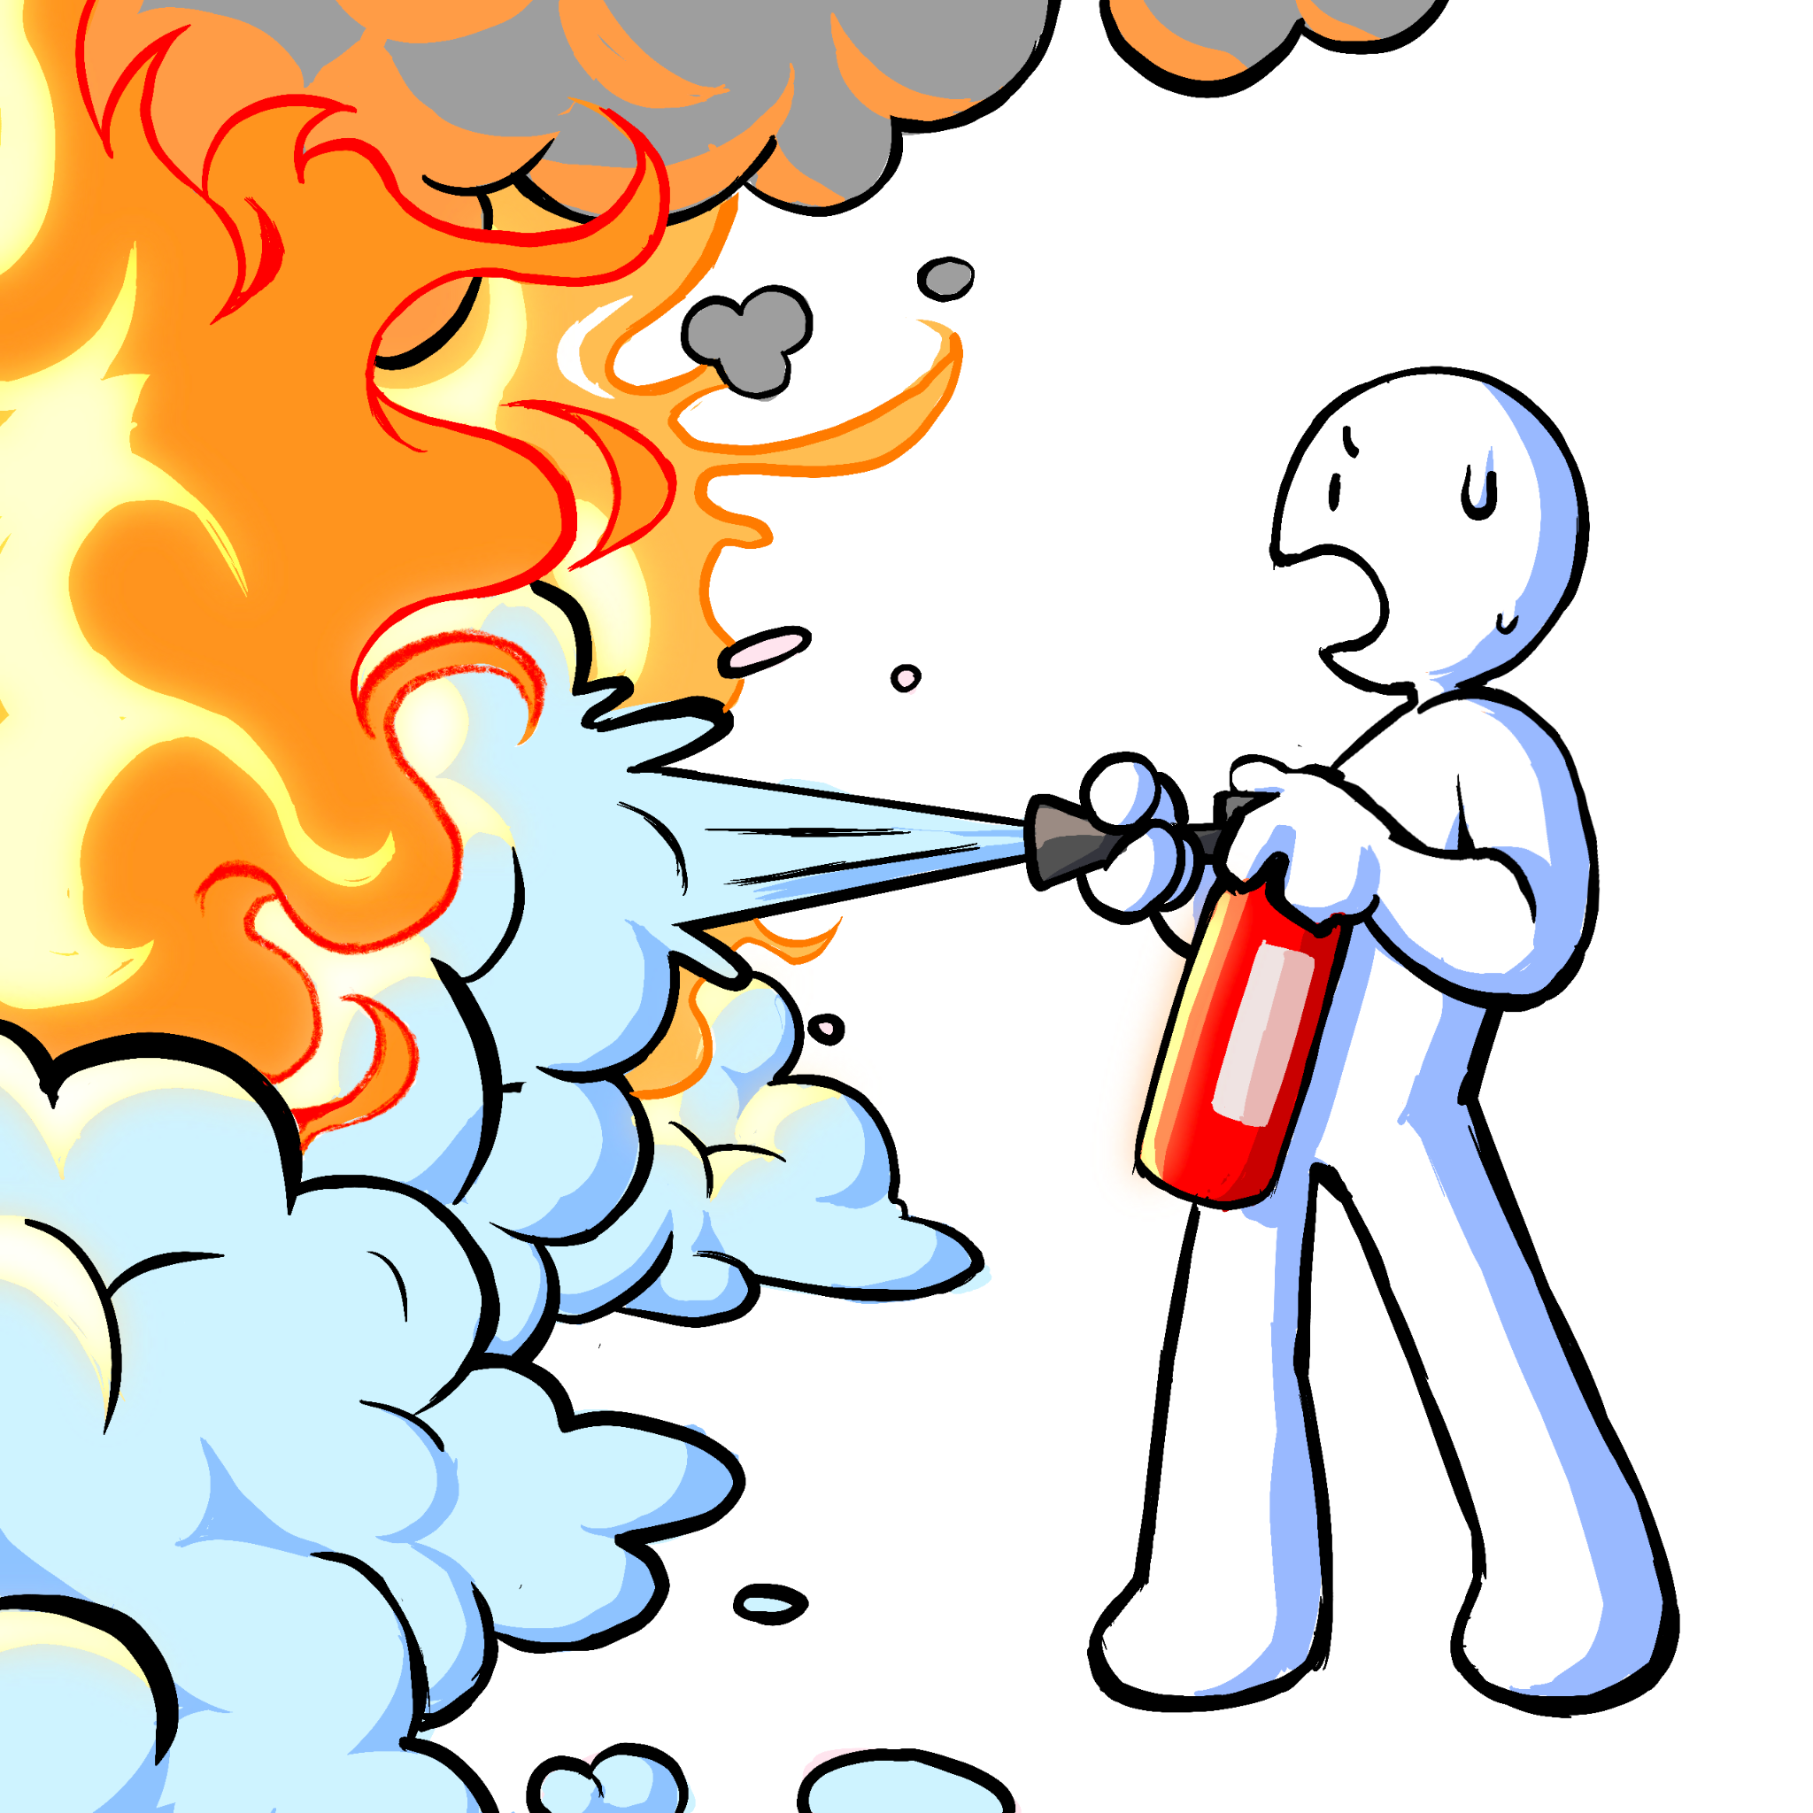
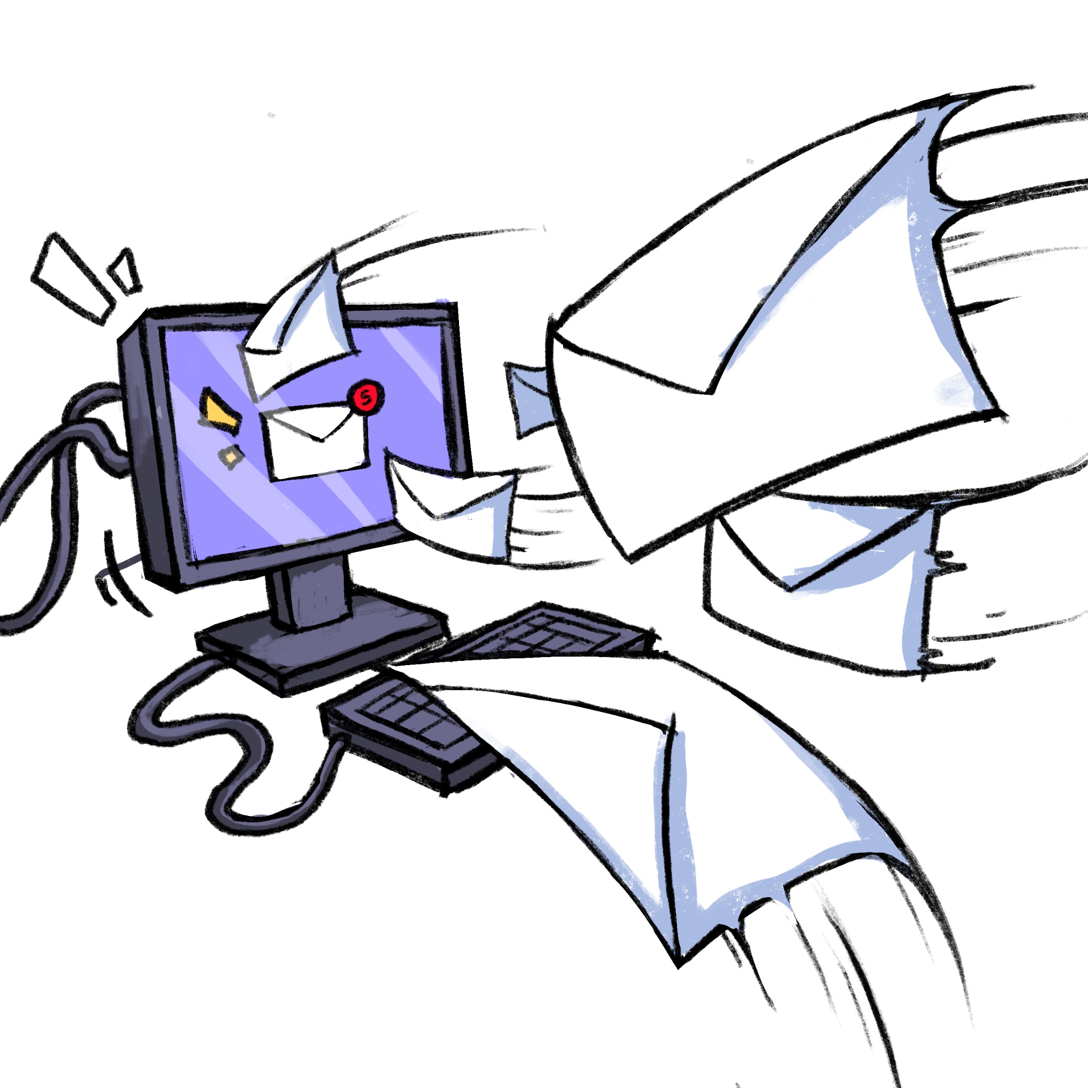
Motivation
Convergence of cybersecurity and physical disasters
cyber.army.mil/Research/Jack-Voltaic
See Dr. Karen Guttieri’s talk (10:15)
Table-Top Exercises

Slide 4
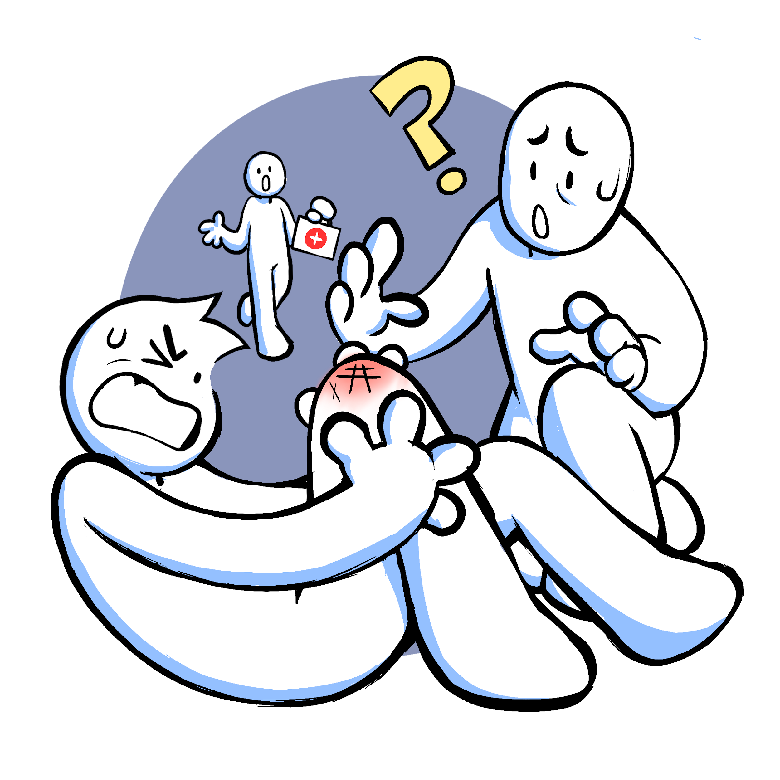
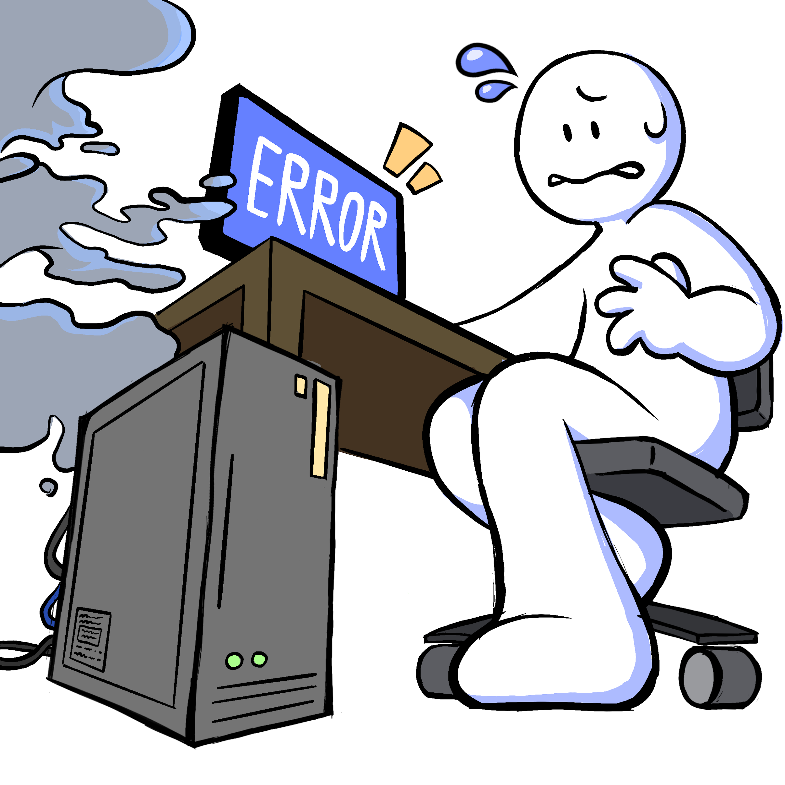

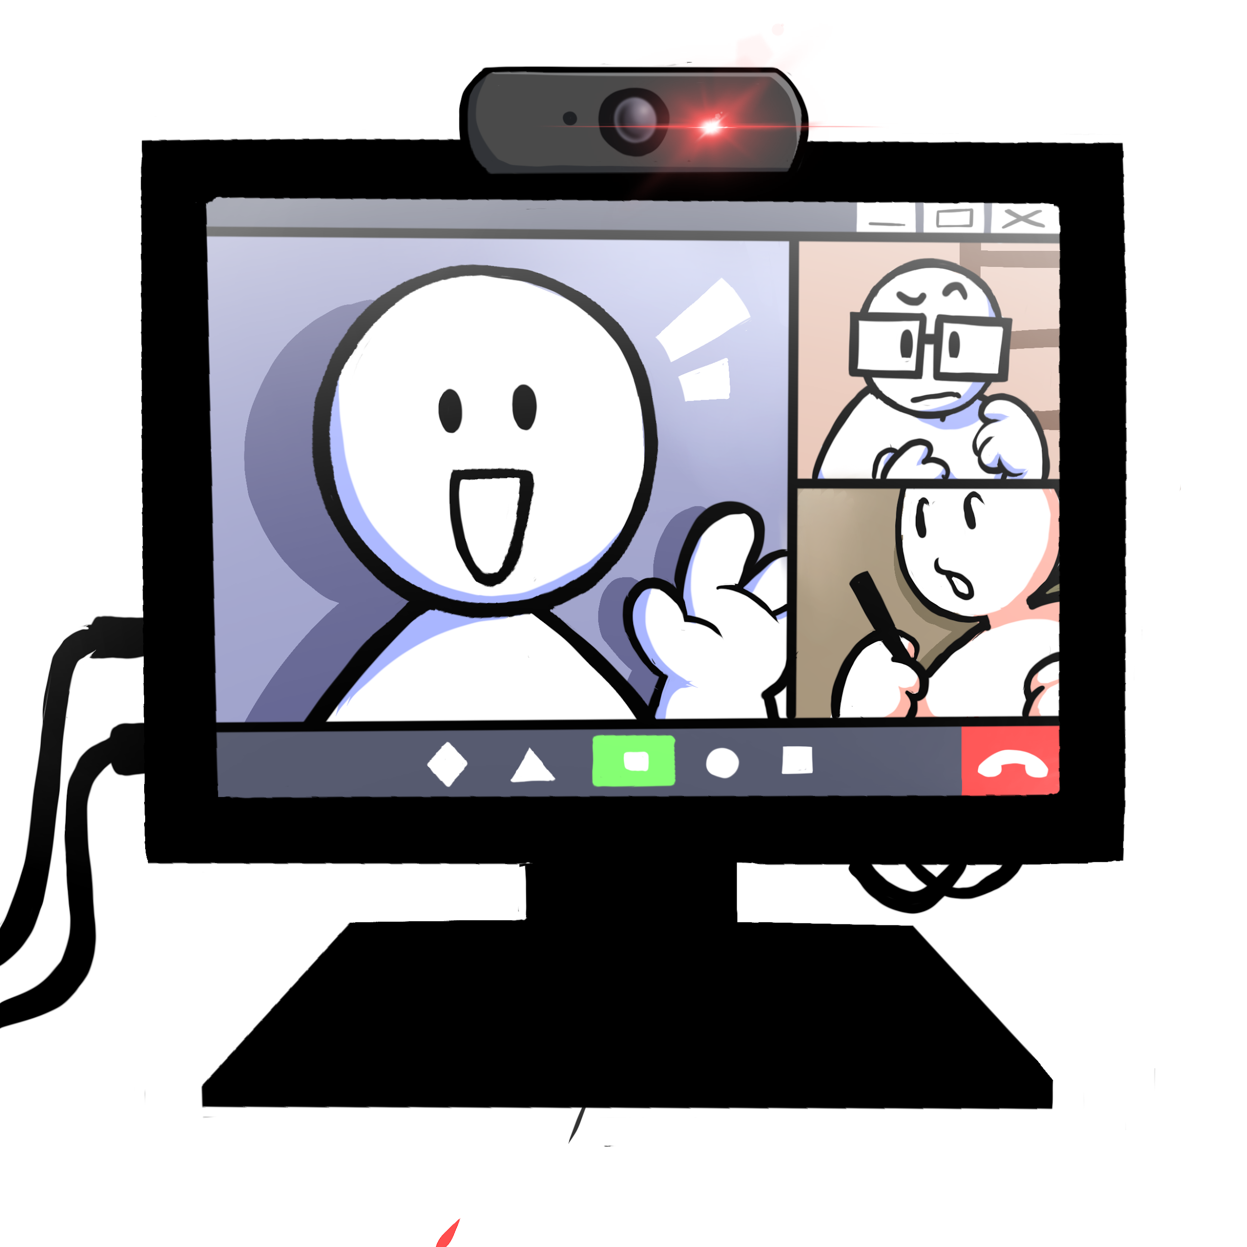
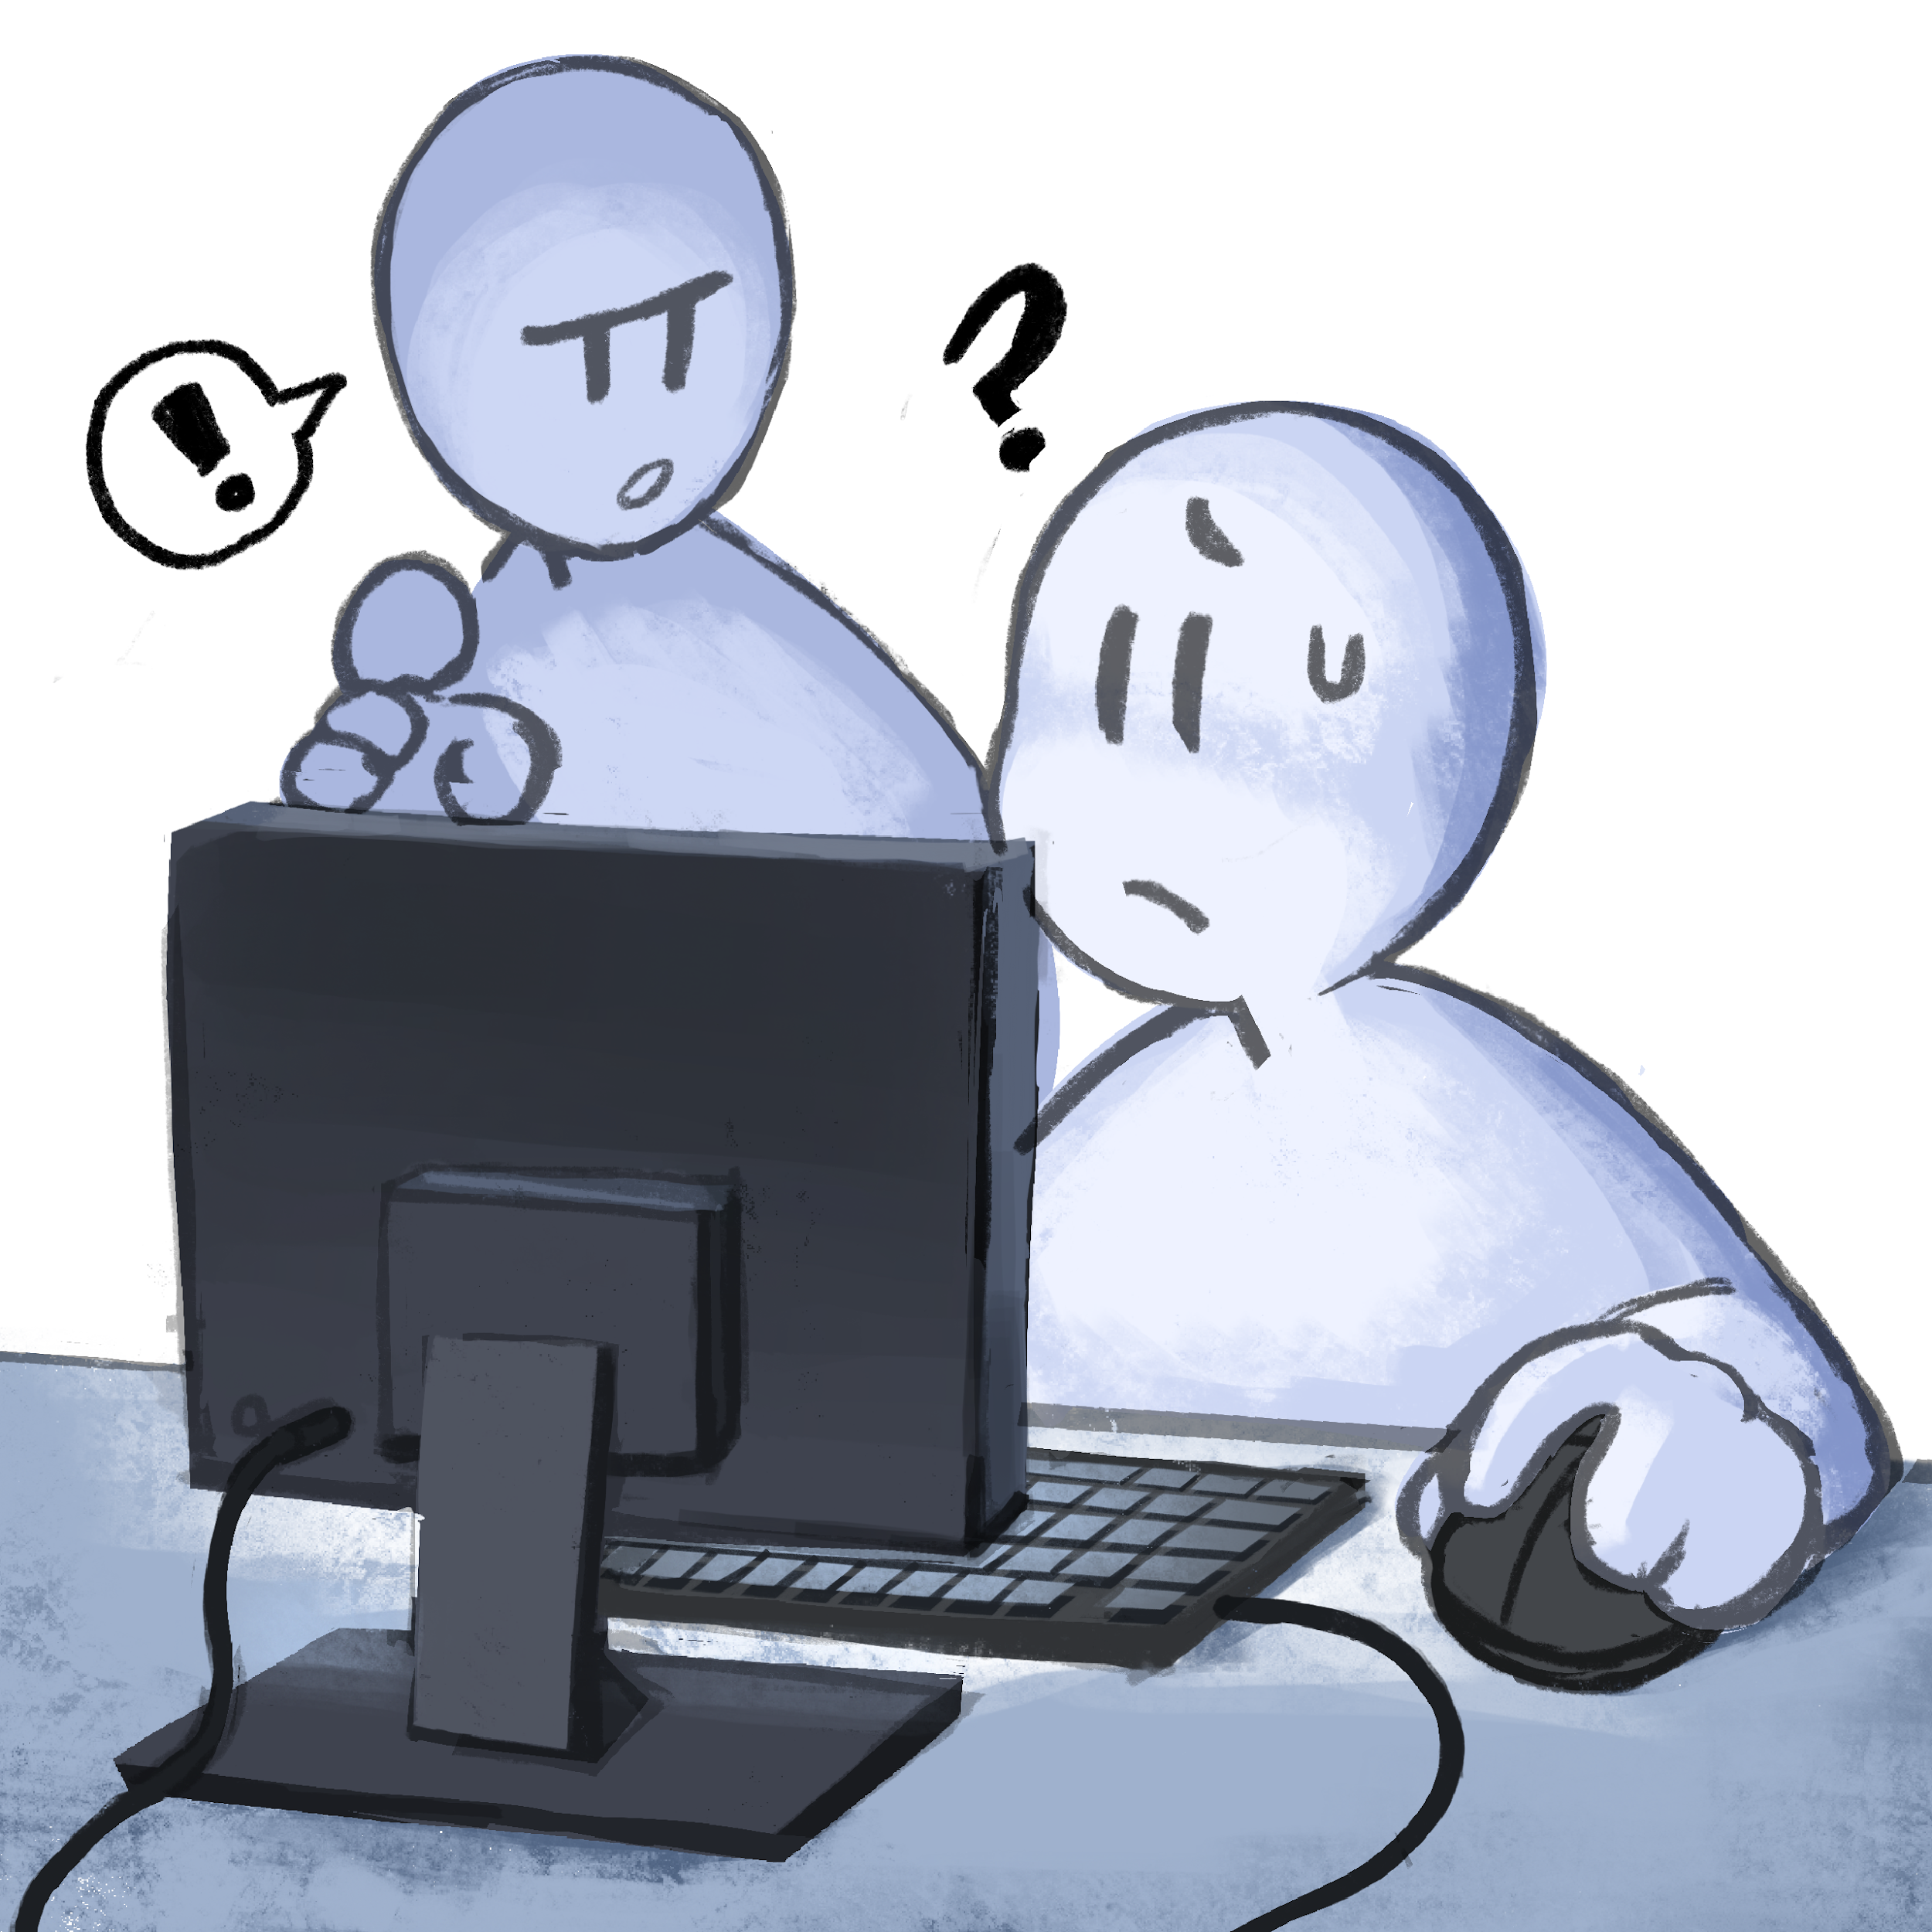
Some Goals
Be more “gamey”
Engagement
Approachability
Less walls-of-text
Speed
Replay value
Adaptability
User editor
Open-Source

Slide 5

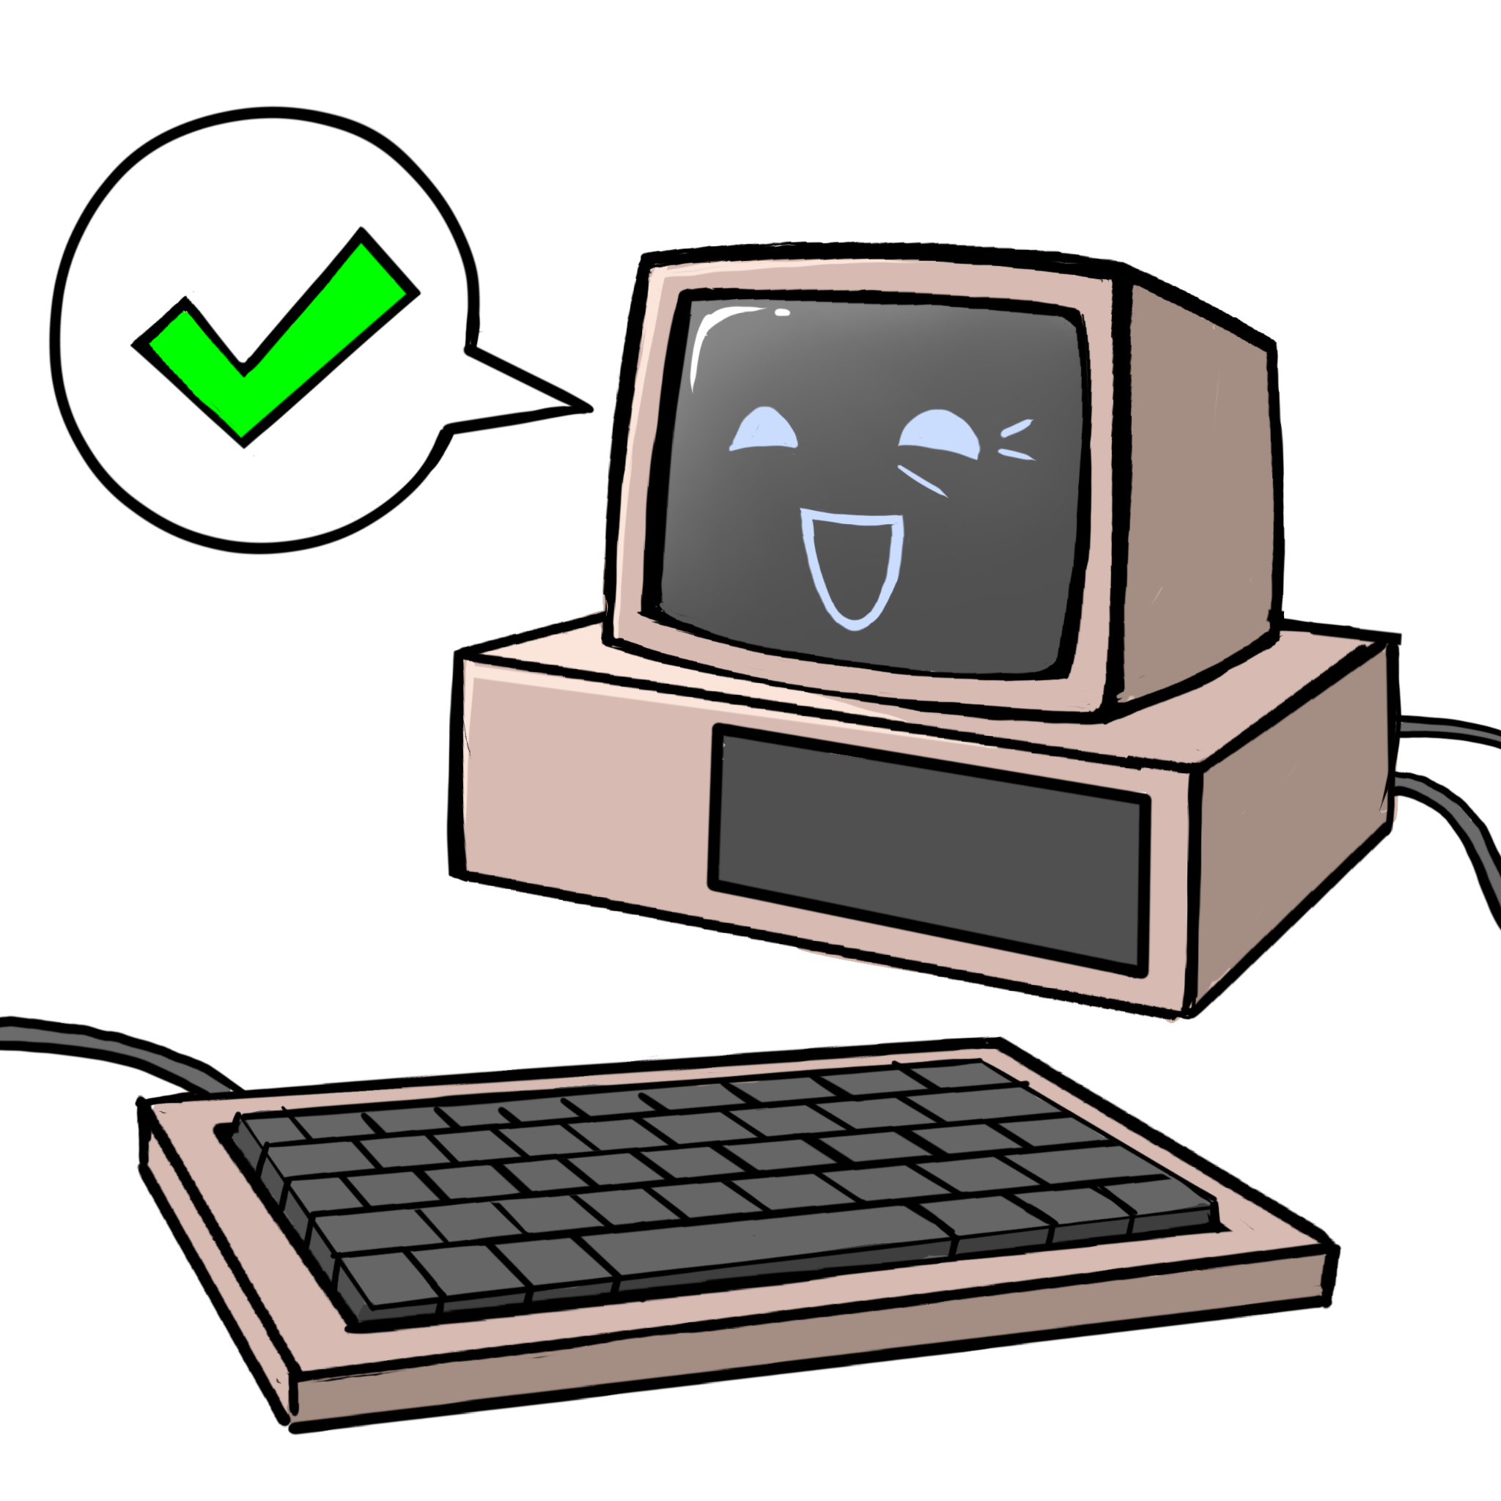
Features
Card-based gameplay
SectorDown (digital)
AccessDenied (analog/digital)
Built-in networking for LAN collaboration
Up to 16 blue players: Critical Infrastructure Sectors | CISA

Slide 6
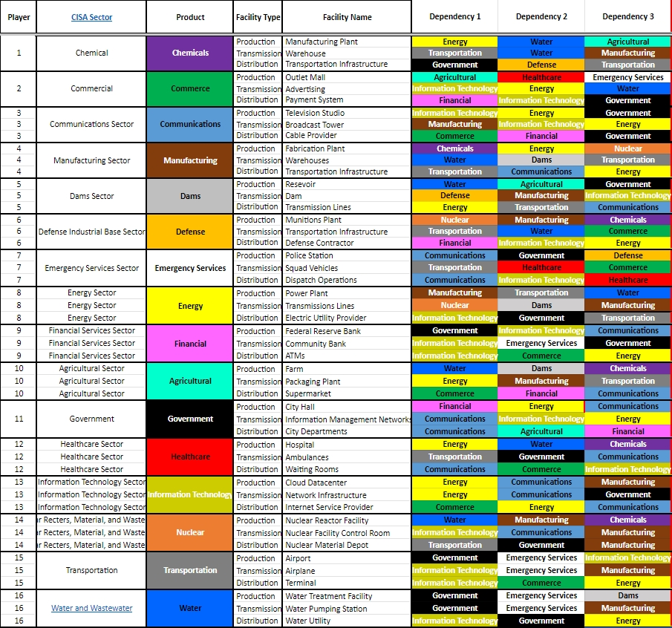

Slide 7
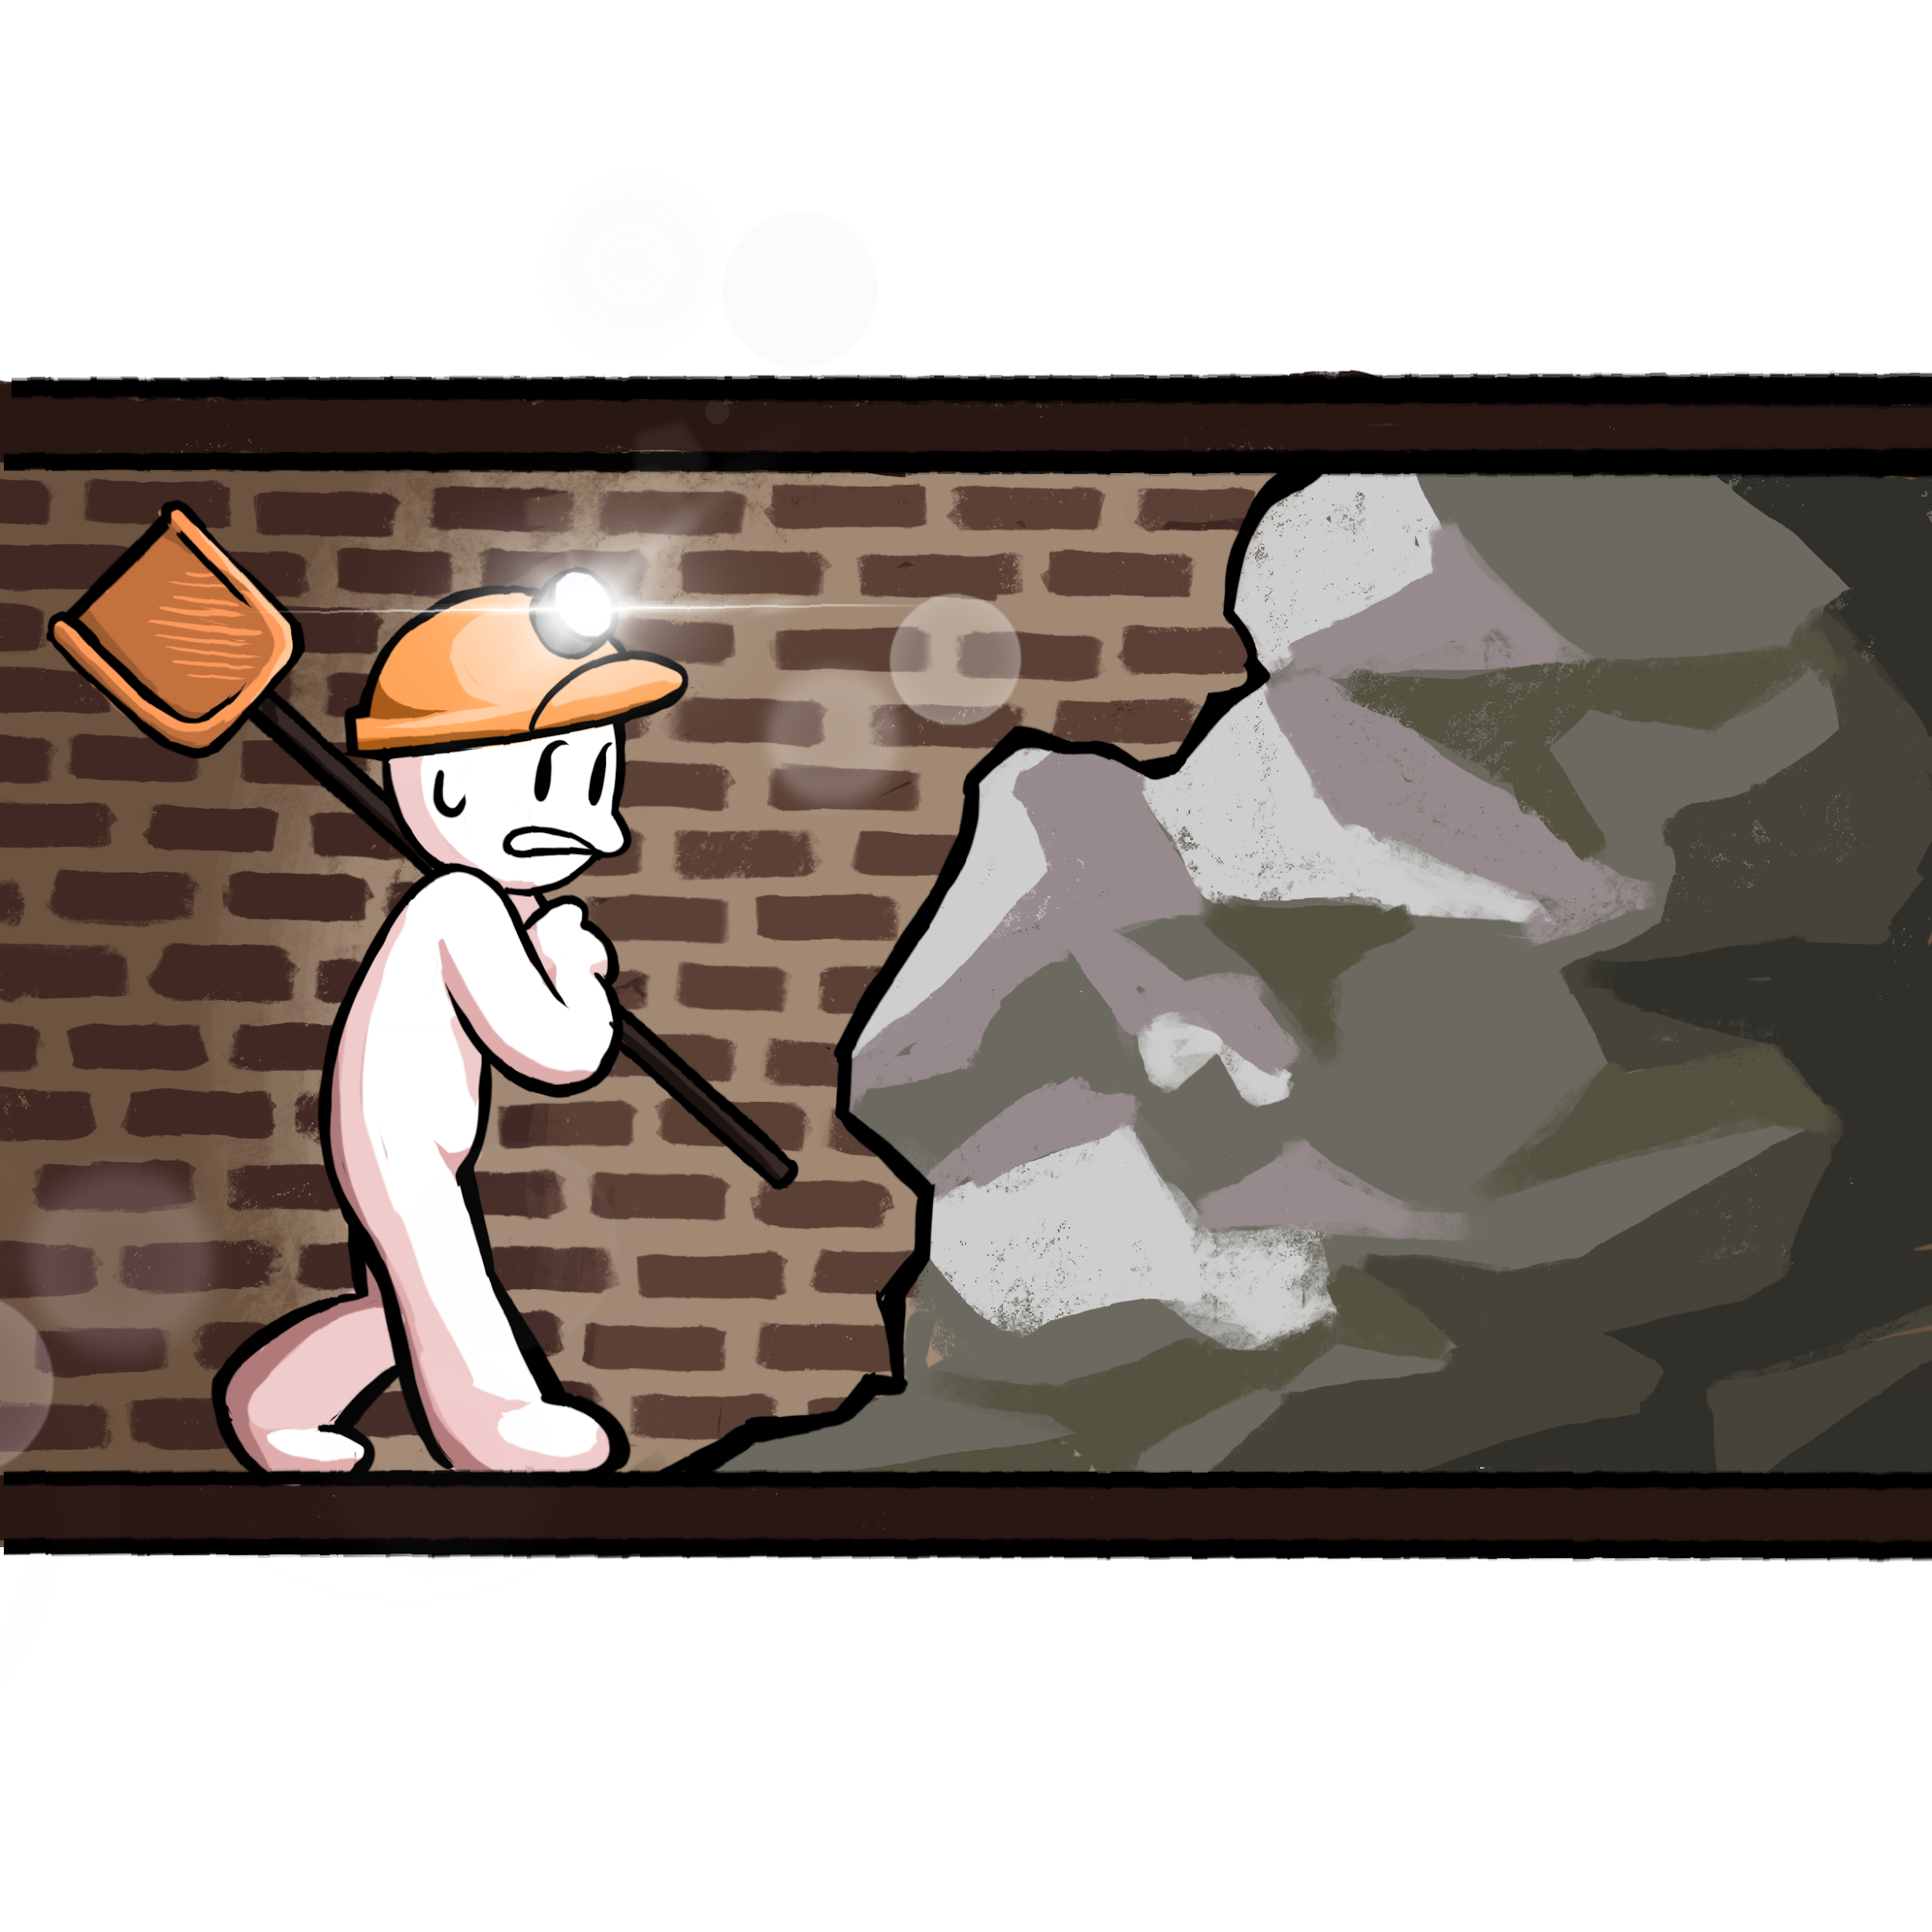
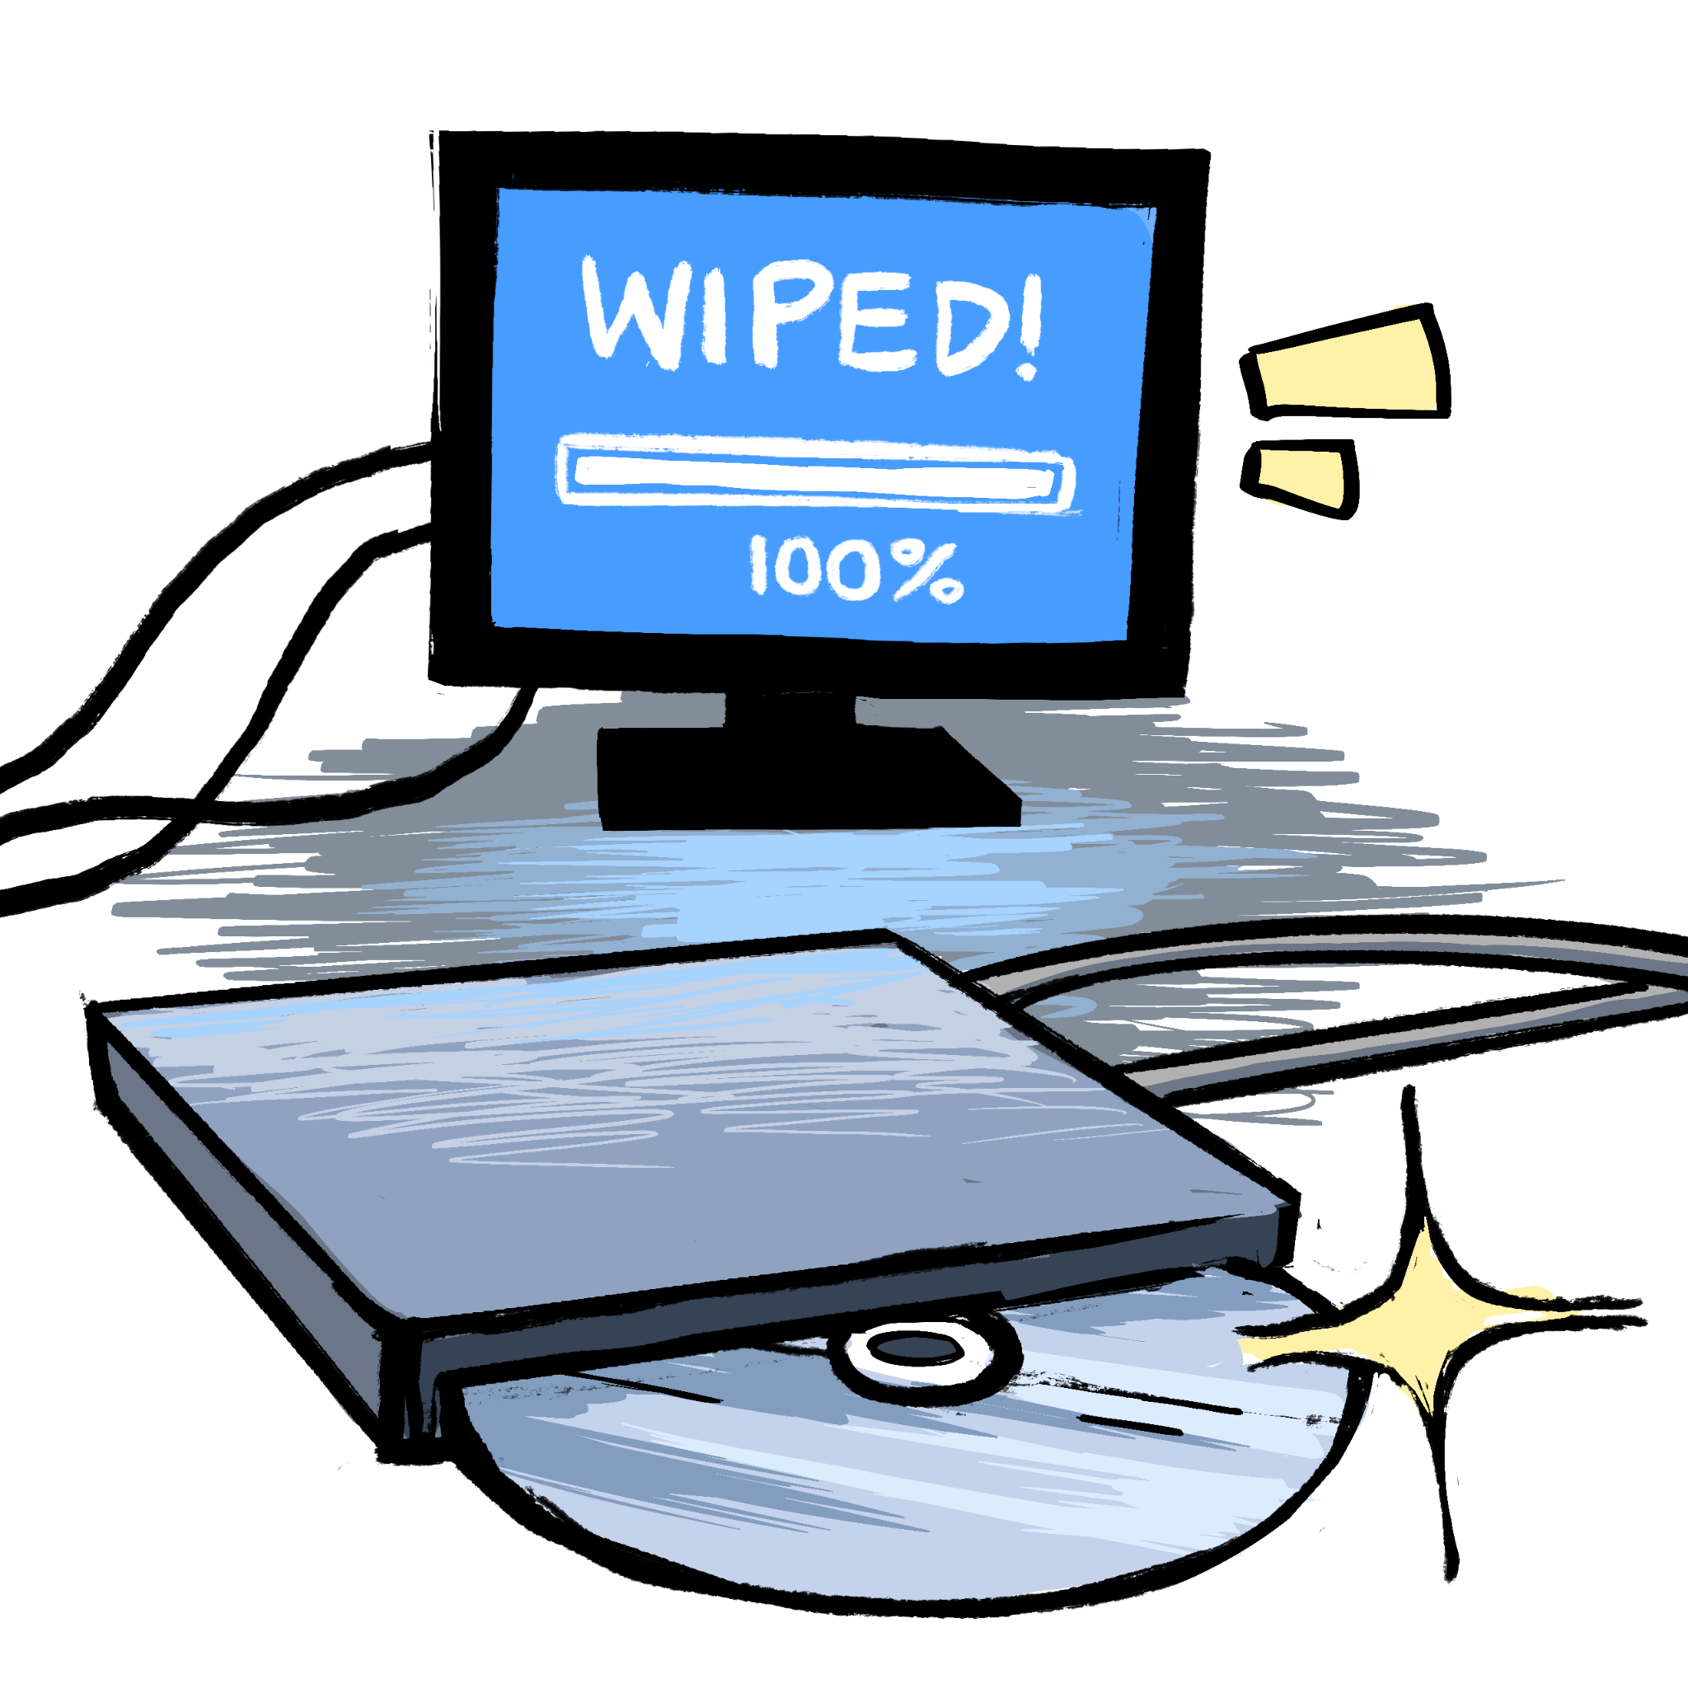
Cards
One red player and remaining blue
White event cards (e.g., physical and natural hazards)
Card editor for modifying base game
Engine can be forked (open source via Github)

Slide 8
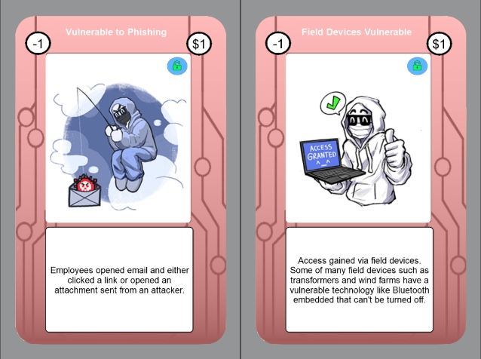
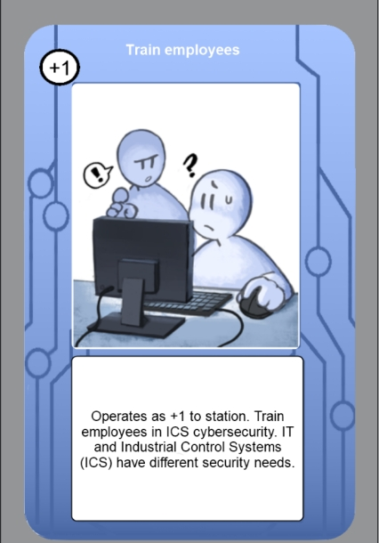

Slide 9
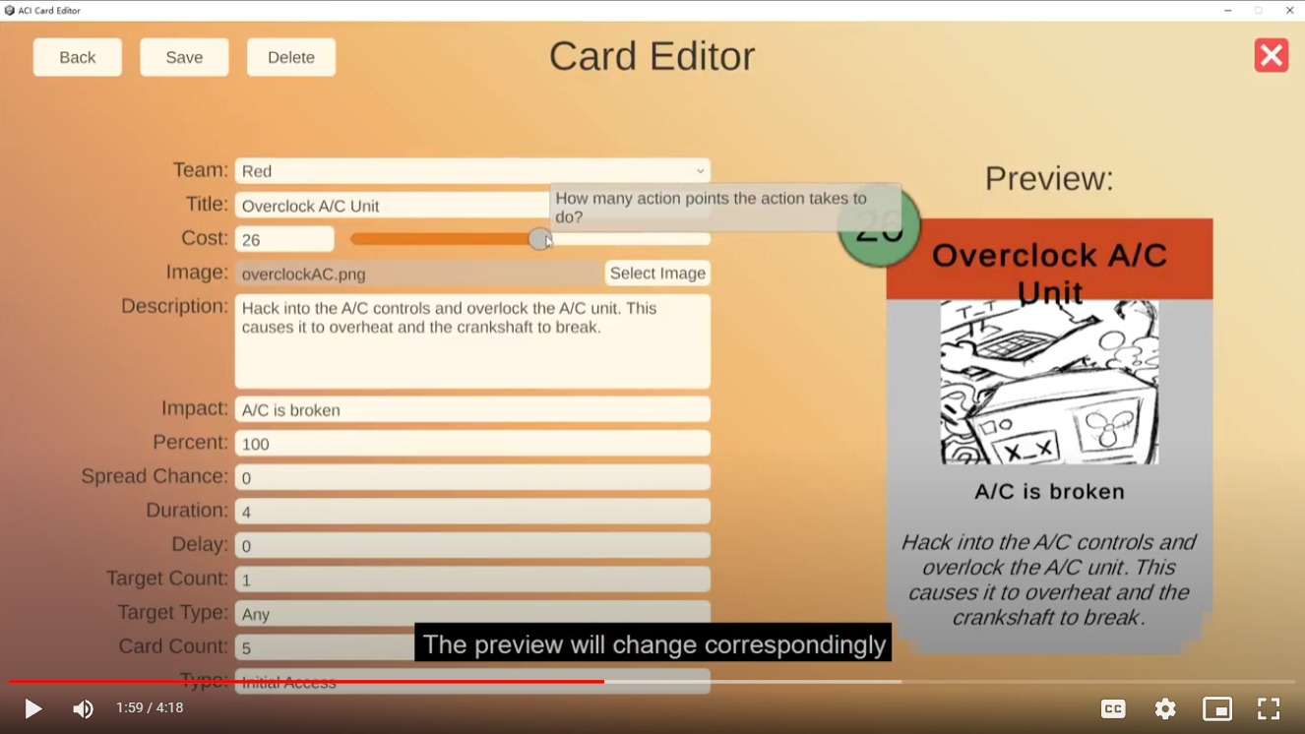
Notes:
Card Editor

Slide 10
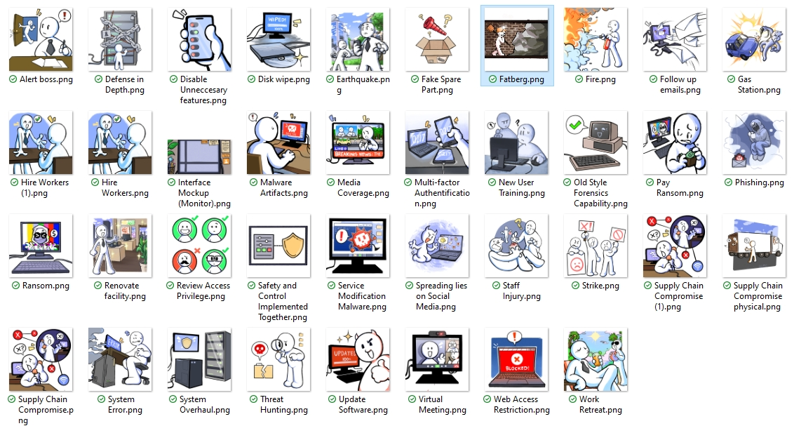
Notes:
Card Images

Slide 11



















Experimenting with Different Interfaces
“Computer View”
“Player View”
Want to capture stakeholder’s info
Next slide, too
Communication
Current workers:
Production Point Facility
Physical
Financial
Network
[Tutorial]
Transmission Facility
Physical
Financial
Network
Distribution Point Facility
Share Meeples

Slide 12
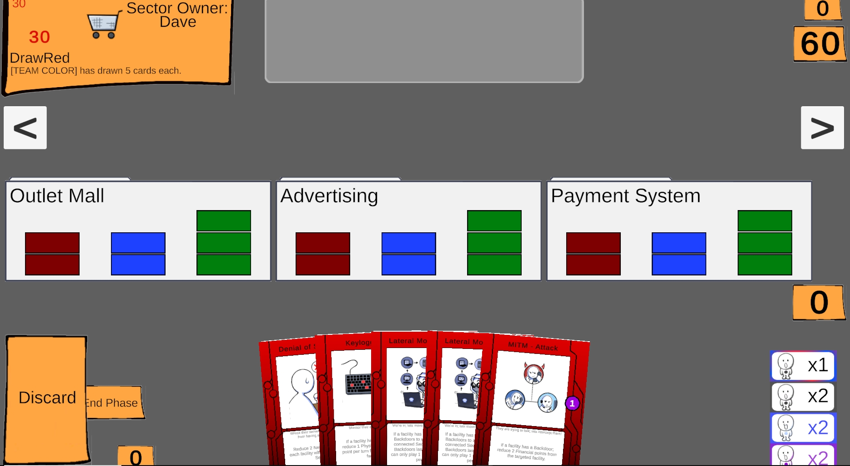

Slide 13
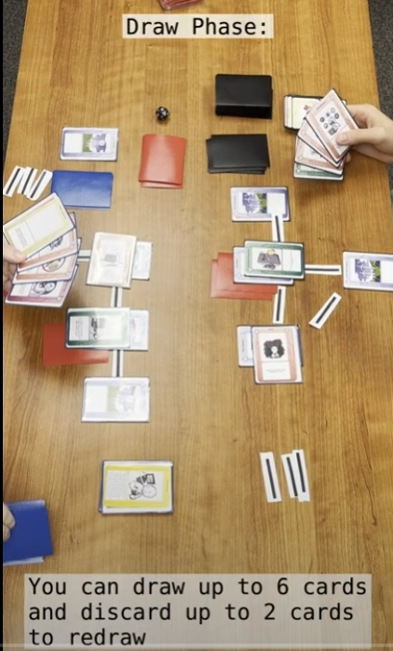
AccessDenied (a bit more)
Forks from SectorDown
Non-cyber security people
Learn some basics about cyber security through learning attack and mitigation terms
Rules: accessDeniedCardGameInstructions.docx

Slide 14
What’s Next?
Some bugs
Final features
Expand multiplayer
Interface cleanup
More testing
Deployment
Future Development

Slide 15


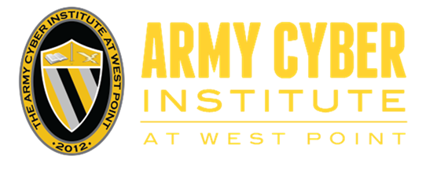




Acknowledgements
This data was produced by Rochester Institute of Technology under United States Military Academy (USMA) Award Number W911NF-23-2-0036. USMA, as the Federal awarding agency, reserves a royalty-free, nonexclusive and irrevocable right to reproduce, publish, or otherwise use this data for Federal purposes, and to authorize others to do so in accordance with 2 CFR 200.315(b).
A large team created this work and related products: students (Liam Andres, Diego Barilla, Sam Beckman, Lizhao Cao, Michael Eaton, Elad Flaison, Ben Garvey, Kevin LaPorte, Mukund Suresh, Emily Nack, Henry Orsagh, Heena Dariel Ravelo-Ramos, Lee Smith, Thadani, Huadong Zhang, James Zilberman), faculty (Jessica Bayliss, Chao Peng, David I. Schwartz, Brian Tomaszewski), a research scientist (Chris Schwartz), and DoD representatives (David Abitbol, Karen Guttieri, Mark McElwain, Steve Whitham, Chris Wilkinson).

Slide 16
Information
ACI:
cyber.army.mil/Research/Jack-Voltaic
Help, demos, videos:
https://www.youtube.com/watch?v=yoc3b1-rJiU
RIT JV _public_
https://bit.ly/rit-jv goes there, too
SectorDown:
github.com/profjdbayliss/RIT-Resilience-Game
AccessDenied:
https://github.com/profjdbayliss/accessDenied/tree/main
pictures and build: JV-Jess Card Game
All artwork (free for use):
https://p1-430-me3870-362e5b544685.herokuapp.com/
https://github.com/profjdbayliss/accessDenied/tree/main/PhysicalCardGame/images
RIT Contact: david.i.schwartz@rit.edu

